Slide 1
4. Encountering Suspicious People
Matt Martin, Iron Sharpens Iron Training Experience, www.isite.training

Slide 2
When to engage with someone suspicious?
NOW. Always prioritize action over passivity.
If you notice something off or different, check it out.
Be friendly, introduce yourself, shake a person’s hand and get a feel for them.
However, if you see very high risk indicators, such as a person wearing a trench coat in summer, or a person carrying a very large bag, etc., invite a team member to go with you and keep distance.

Slide 3
Communication with your team
State clear, concise information over the radio, then get off the radio so others can communicate
State name, situation, location. For example, “This is Amy - there’s a man in a trench coat in the Kids parking lot walking towards the Kids entrance.
He’s coming down the aisle directly in front of the entrance.”
Then Amy gets off the radio. Someone else responds. “This is Mark, copy - Fred
and I will check it out.”
Designated 911 contact person is ready in case a request for 911 goes out.
Be ready to communicate with safety team members to lockdown doors, etc.
Be ready to communicate with church leadership/and or the entire church

Slide 4
Communication with the person
If the person who has threat indicators looks to be different but isn’t exhibiting high threat indicators
Approach them in a friendly manner with your hands up near your chest
Introduce yourself - “Hi, my name is … What’s your name?”
Offer to shake their hand
Ask if there is any way you can help them. This can be a great opportunity to welcome and help someone.
At this point you can get a feel for this person and their mental state. Are they just feeling nervous because this is their first time at church? Or maybe they are high on drugs or drunk? They could have a mental issue, etc. If you get a vibe that they have evil intent, get some help/backup.

Slide 5
Contact and Cover Teamwork
In the case where you identify someone with potentially high risk threat indicators (large bag, trench coat, angry demeanor, etc.), Threat Response team members operate in groups of at least 2
One person will be the contact person, the other will be the cover person
The contact person handles all of the communication with the suspicious person. They are ready to welcome them and use OC spray or put hands on them if necessary.
The cover person is a bit off to the side of the contact person. They are able to observe the big picture and warn the contact person if another person starts to approach, etc. They are ready to come to the contact person’s aid if a physical altercation takes place. They are also ready to draw and deploy pepper spray or a pistol if needed. Be mindful of your backstop and position yourself in such a way as to make that backstop as safe as possible.

Slide 6
Contact and Cover
Hi sir, could you please stop right there? I’m Jeff with the church’s safety team.
Cover
In a good flanking position
Contact
If possible, position yourself to have cover between you and the suspicious person.
At an angle, not directly in front of the suspicious person

Slide 7
Contact and Cover
Cover
Armed with pepper spray and a pistol. Is ready to
cheat the draw with the pistol in the case where the person is displaying signs that are extremely dangerous.
Contact
Ready to welcome people with grace. Is also armed with pepper spray (non lethal) and a pistol (lethal). At first, ready to respond with pepper spray if the need arises.

Slide 8
Create a verbal boundary*
Set a boundary with a verbal command. Stay at least 10 feet away from the person to give yourself reaction time and options. If possible, have a car, table, tree, or other object between you and them.
You want the command to be assertive, but not something disrespectful that will escalate the situation. For example, “Hi sir, please stop right there.”
If the person obeys your command and stops, that’s a good sign. Then you can talk with them and ask about their trench coat, bag, etc.
If they don’t stop and keep coming, you’re already in conflict and you should be ready to act. The contact person should loudly yell “Stop!”.
If they keep coming you’re likely already in a fight (unless you are dealing with someone who has cognitive issues, is deaf, etc.). Continue to back up to help create distance.
* Based on “Managing Unknown Contacts” from Craig Douglas of shivworks.com. You can take his classes in person or watch the class on WatchWPSN.com $10/month

Slide 9
How to read them
To help discern the person’s intent, look at:
Their eyes - helps convey their mental and emotional state
Their hands - if they start to ball up into fists or reach for their waistband, react accordingly.
Their stance - if they keep coming at you aggressively or start to square off, be ready.

Slide 10
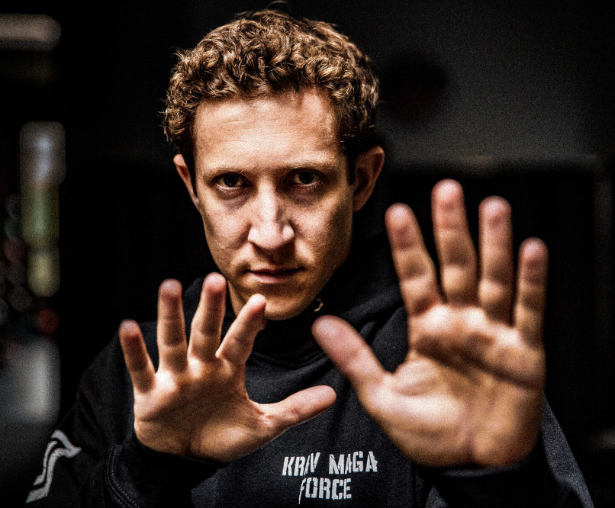
Hands up if they keep approaching
Contact
Keep your hands up in a non-aggressive stance. That way you can protect yourself from a sucker punch or draw OC spray or a pistol if the person pulls a weapon on you. Do NOT have have your hands down at your sides if they are within your reactionary gap (reactionary gap is within the distance where they could punch or kick you).

Slide 11
De-escalation (LEAPS) technique
We win 100% of the fights we can avoid.
“Blessed are the peacemakers, for they shall be called sons of God” - Matthew 5:9
“Our struggle is not against flesh and blood, but against the rulers, the powers…” - Ephesians 6:12
Verbal Judo: The LEAPS method
Listen
Empathize
Ask questions (what, how, why?)
Paraphrase (or mirror)
Save face - allow them a way out that avoids shame
Example - “I hear what you’re saying, but we’re at church - let’s …”

Slide 12
Set up a positive alternative.
Don’t make it personal.
Keep the focus on a policy to keep people safe, not on yourself.
Ask - “I need you to move outside…”
Set context - “as part of our policies to keep people safe.”
Present options - positive option first “If you go outside, that’s great. If not,
I’ll need to contact the police and they will arrest you for trespassing.”
Confirmation - “Ok, so you’re going to go outside.”
Act - follow them out, or ask for a team member to contact 911, etc.

Slide 13
When are you allowed to defend yourself?
Check your local laws. Generally, you are legally able to defend yourself or others when:
There is a reasonable belief
(what a reasonable person would believe)
That there is an imminent threat
(where the means to accomplish the threat are present)
Of bodily injury, harm, or death
Example: If a man in the lobby says that he will run over you with a 747, is that an imminent threat? Should you
shoot him? No! There is no 747 in the lobby - he does not have the means to accomplish the threat.
However, it doesn’t mean he isn’t dangerous and that you shouldn’t ask him to leave.
Example: If a man in the lobby squares up his stance, puts up his hands in a boxing fashion, and says that he will hit
you, is that an imminent threat? Yes. He has taken actions that make a reasonable person believe
that he is about to cause bodily harm. This could be a good point to get away and/or OC spray this person.
Example: If a man comes in, takes out a gun, and says that he will hurt people, is that an imminent threat?
Yes. He has the taken actions that make a reasonable person believe he will cause harm or death.
You can respond with proportional force - put hands on him, OC spray him, or shoot him to protect
yourself and others.

Slide 14
Force Continuum
How are you allowed to defend yourself?
Presence
Verbal Interaction
Non-lethal
Lethal
Low Force
Extreme Force
As a citizen, you are only legally able to respond to force shown against you or others with a reasonable, proportional response. You can face legal action if you escalate force.
For example, if a person is verbally insulting you or others (calling you names, etc.), you are not authorized to respond with physical force. If they are pushing you (non-lethal force), you are not allowed to respond to with lethal force.
It is important to have a non-lethal option such as OC spray that is something between a harsh word and a gun.

Slide 15
You are private citizens and NOT Law Enforcement.
You are not authorized to put hands on people if they don’t threaten you or others first. You are only allowed to defend yourself and others, the same as any private citizen.
Contact law enforcement for combative or resistant people. Try to de-escalate and disengage if possible.
If you ask a person to leave and they won’t, let them know that they are trespassing and that you will call law enforcement to come arrest them if they don’t comply. Wait for law enforcement if the person refuses.
Physical force is a last resort.

Slide 16
Scenarios to Practice
First, do a double check and pat down to ensure that everyone is disarmed.
Then, simulate the following:
A person in a trench coat approaches
A homeless person approaches and is upset
A person with a large bag approaches
A parent doesn’t have the claim ticket to check their child out of kids service
and is upset that they have to confirm their identity.

