Slide 1
10. Active Killer Response:
Scenarios
Matt Martin, Iron Sharpens Iron Training Experience. www.isite.training

Slide 2
Scenarios you could encounter
Someone pulls a handgun in the sanctuary and starts to fire
Someone pulls a handgun in the lobby and starts to fire
Overwatch sees a person with a long gun in the parking lot
You hear or respond to shots at a distant location. You have to room clear as you find the threat
Shooter has body armor
There are 2 or more shooters - ISIS K 2024 Moscow theater attack
Shooter uses a distraction —pipe bomb, fire alarm, etc., then engages somewhere else

Slide 3
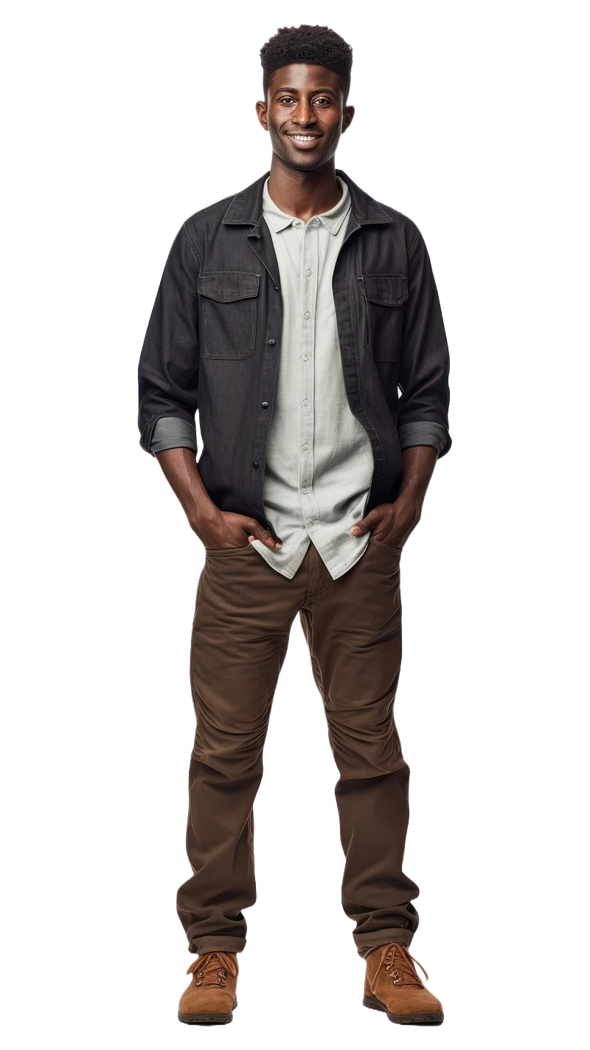
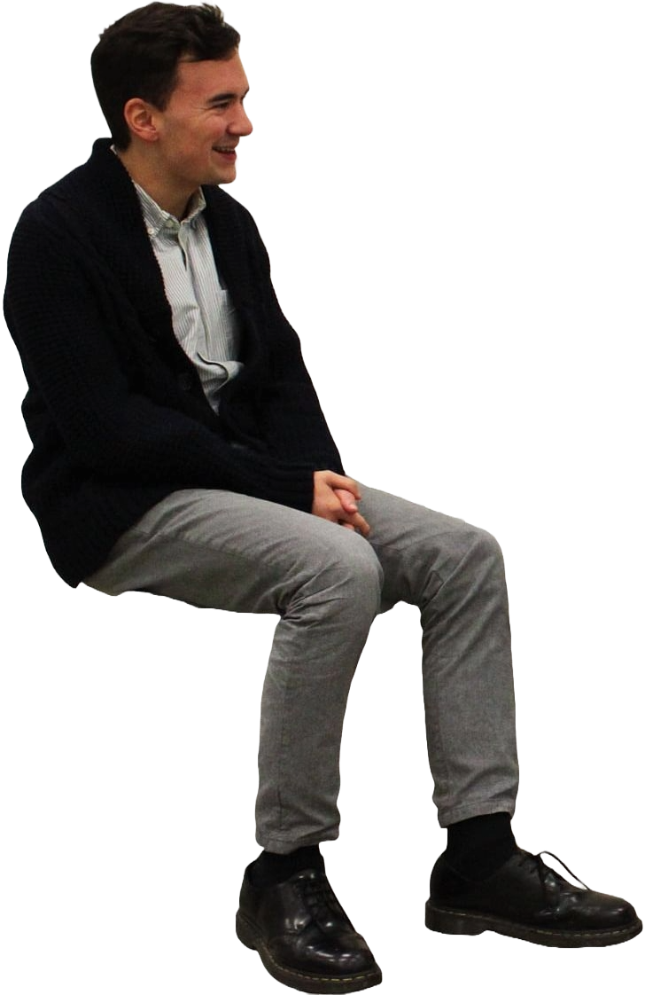
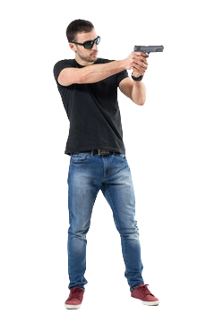
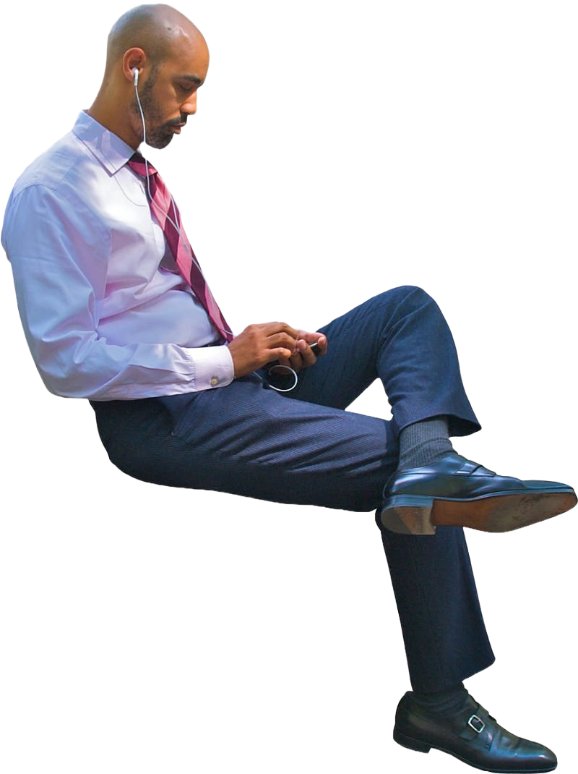
Threat
Sanctuary
Kids Area
Chapel
Lobby
Scenario 1 - person pulls a gun in the sanctuary

Slide 4
Team members respond based on the circumstances
Safety team member lets team know on the radio.
Communications person contacts 911.
Kids team locks doors.
Safety team in the sanctuary responds and neutralizes threat
Team members in the lobby move to sanctuary to help

Slide 5
Threat
Sanctuary
Kids Area
Chapel
Lobby
Threat
The threat could be in many different locations - back of the stage, by a door, in the balcony?
They could come up behind one of the safety members and ambush them.

Slide 6
Threat
Sanctuary
Kids Area
Chapel
Lobby
Scenario 2 - person pulls a gun in the lobby

Slide 7
Team members respond based on the circumstances
Safety team member lets team know on the radio.
Communications person contacts 911.
Kids team locks doors.
Safety team in the lobby responds and neutralizes threat
If there are multiple armed members in the sanctuary and/or kids area, keep one in reserve but send the others to the lobby to help

Slide 8
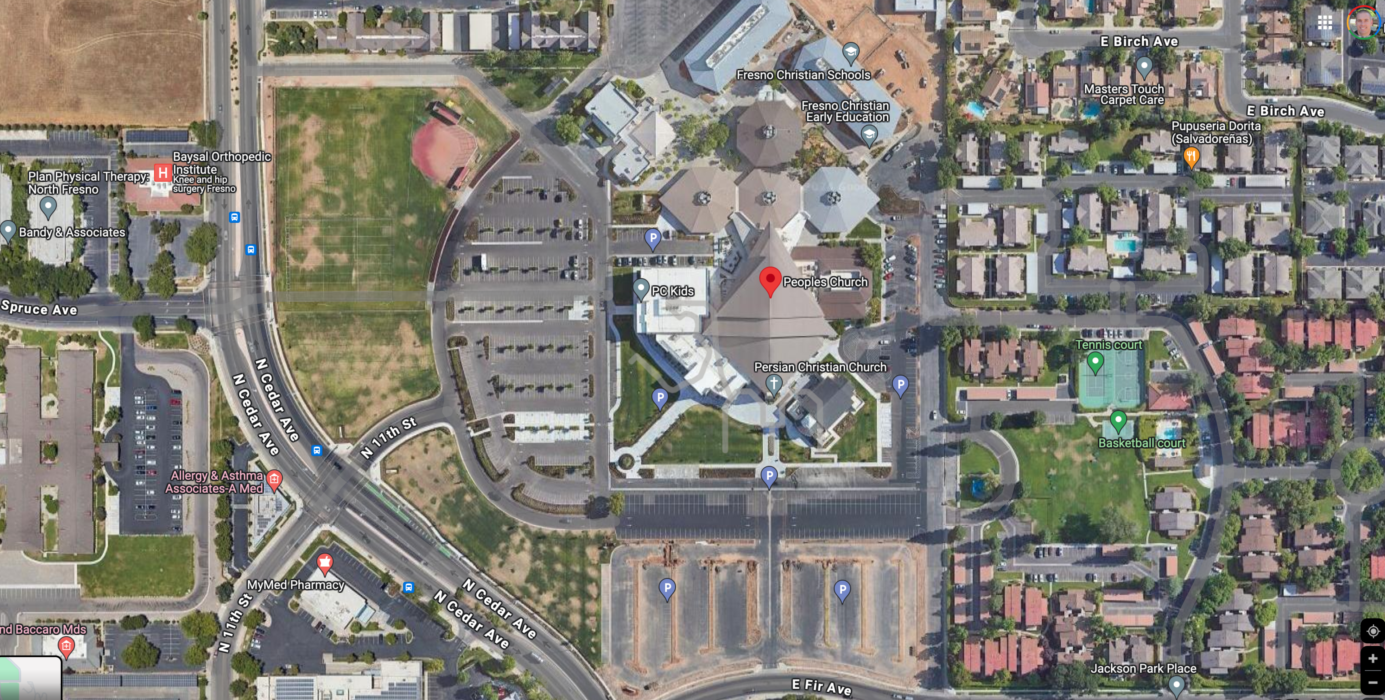
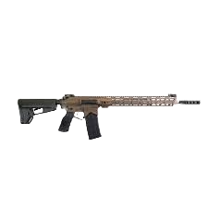
Scenario 3: A person with a long gun in the parking lot

Slide 9
Team members respond based on the circumstances
Overwatch lets team know on the radio.
Communications person contacts 911.
Access team locks external doors (if they have time).

Slide 10
What do threat response team members do?
If the threat is shooting at people in the parking lot, go stop the threat (in teams of at least 2). Use teamwork to flank the threat and cover/concealment when possible.
If the threat is not actively shooting, get behind cover/concealment inside the church building and ambush the threat once the threat comes to you.
Other safety team members direct people away from the windows and doors to safety
If you have long gun(s) and plates/body armor, get them.

Slide 11
A person actively shooting with a long gun in the parking lot
Overwhelm their OODA loop with a spread out response - don’t pack up close together
Get a partner - don’t go by yourself. Use cover fire and move to cover. Flank the threat.
You can shoot through car doors, trunks, and windows. Use the engine block as cover.
You can also shoot a person in the ankles/feet shooting under a car

Slide 12
A person with a long gun (not shooting)
Get behind cover/concealment inside
Shoot them through the glass or as they come through the doorway

Slide 13
Threat
Sanctuary
Kids Area
Chapel
Threat
Lobby
Scenario 4 - You hear gunshots from the kids area, north lobby or chapel,
but don’t know exactly where - and the shots stop.

Slide 14
Team members respond
Safety team member lets team know on the radio.
Communications person contacts 911.
Access team locks doors (unless shots are coming from the kids area)
Armed safety team members closest to the shots form teams of at least 2, respond, room clear if necessary, and neutralize threat
If there are multiple armed members in the sanctuary, lobby, and/or kids area, keep one in reserve per area but send the others to help

Slide 15
Threat
Sanctuary
Kids Area
Chapel
Lobby
Scenario 5 - killer has body armor (this could be outside, too)

Slide 16
Tactics
Failure drill - initially target center mass, but if that does not stop them, target the head
Zipper drill - target center mass and keep aiming higher as you move up to target the head
If he has a ballistic helmet too, aim for the crotch, hips, legs, ankles, seams in armor, etc.
Respond with long guns and plates/body armor if you have them

Slide 17
Scenario 6: Multiple attackers approach
Similar to scenario 3, but much more dangerous. Get behind cover and ambush as they enter.
If you have long guns and plates/body armor, get ‘em.

Slide 18
Scenario 7: The fire alarm has been set off or a pipe bomb goes off, a person(s) with a gun in the parking lot attacks as people evacuate
Make sure armed safety team members go to parking lot first and escort people as they evacuate.
Be aware of any items (bags, etc.) that someone leaves in an area - could be a bomb.

Slide 19
Now we’ll run scenarios.
Either outside with airsoft in a large tent with chairs set up to simulate a sanctuary, and/or inside with laser technology, possibly StressVest, with pistol conversion kits using blank rounds and lasers. Use a blank gun to simulate the sound of gunfire.

