Slide 1
3. Identifying Potential Threats
Matt Martin, Iron Sharpens Iron Training Experience, www.isite.training

Slide 2
Recognizing potential threats
Pre-threat indicators
Person is scanning nervously with their eyes
They are hiding their face - chin tilted, hoodie or mask
Clenched fists
Fidgety, nervous - pacing, rocking on the balls of their feet
Grooming: any touching around the face, hair, neck
Avoiding eye contact
Posturing while acting busy
Thousand yard stare
Picking of the waist: elbow checking, repetitive touching
Sweating or flush white in the face
Out of the ordinary dress or behavior
Trench coat in summer, large bag/backpack for no reason, etc.

Slide 3
Examples of active killers at churches
Charleston, SC 2015 - 21 year old white supremacist male, wearing a sweatshirt and jeans, concealed Glock 41 pistol, killed 9 people and wounded 1 at a Bible study at an African American church on a Wednesday night. Tried to commit suicide but ran out of ammunition.
Sutherland Springs, TX 2017 - 26 year old white male, ballistic vest, ballistic helmet, ar-15, opened fire outside the church and shot 2 people, went into the church, killed 26 people and wounded 22. Was shot and killed by a civilian (Stephen Willeford) who responded with an ar-15.

Slide 4
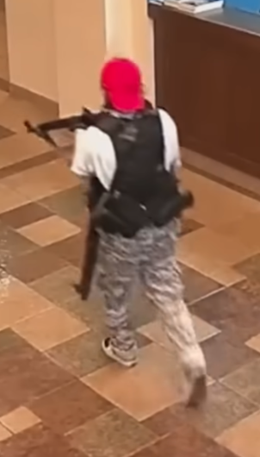
Examples of active killers at churches
White Settlement, TX 2019 - 43 year old man wearing a fake beard, wig, hat, and long coat pulled out a short barreled shotgun with a pistol grip during communion and shot 2 people. He was shot by Jack Wilson, leader of the church’s security team.
Nashville, TN 2023 Covenant School and Church - 28 year old woman armed with 2 rifles and a pistol shot through a set of glass doors and killed 3 children and 3 adults. Was shot and killed by responding police.

Slide 5
Houston, TX 2024 - 36 year old woman in trench coat with backpack brings her 7 year old child with her into the lobby, takes an AR-15 out of her bag and opens fire. Wounded 1 person. Was shot and killed by a member of the security team.

Slide 6
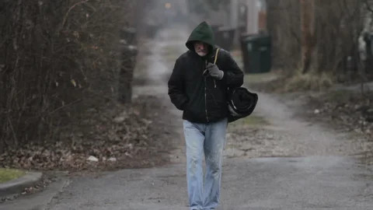
However, it’s far more common to encounter a homeless person
We want to welcome then with the love of Christ, and direct them to a ministry where they can receive help, while evaluating if this person may be a threat to others.

